Slide 1
AI-Powered Diet Recommendation System: Revolutionizing Personalized Nutrition
TO Discover how artificial intelligence is transforming how we approach diet and nutrition, moving beyond one-size-fits-all advice to deliver truly tailored health solutions.
BY- PratYAy Roy (23BBS0033) Srinjan Nandy (23BBS0045)
Riddhi Basak (23BBS0092)

Slide 2
Objectives
The primary objective of the AI-powered Diet Recommendation System based on Health Profile and Goals is to develop an intelligent and personalized nutrition planning tool that analyzes an individual’s health parameters, dietary preferences, and wellness goals to provide scientifically accurate and customized meal recommendations.
The system will leverage machine learning, nutritional databases, and user input (such as age, gender, weight, height, medical conditions, activity level, and food preferences) to:
Promote healthy eating habits by recommending balanced, goal-specific diets (e.g., weight loss, muscle gain, diabetic-friendly plans).
Enhance health outcomes by aligning meal suggestions with medical constraints and nutrient requirements.
Provide real-time adaptability by adjusting diet plans based on progress tracking and lifestyle changes.
Reduce human effort in diet planning through automation and AI-driven decision-making.
In short, the project aims to create a smart, adaptive, and user-centric nutrition assistant that supports long-term health and wellness goals.

Slide 3
Literature Review
Abstract: This report presents a multi-faceted food recommendation system encompassing three key components: dietary guidance, personalized recipe or food suggestions, and protein content prediction for new products. The first component provides tailored calorie recommendations based on individual parameters such as age, weight, and height, catering to goals like weight maintenance, loss, or gain. The second offers food and recipe suggestions aligned with specified caloric and nutrient requirements. Lastly, we designed a system that utilizes a neural network model to predict protein content in new food products based on which market sizing and product adoption have been taken into account. These integrated approaches harness machine learning techniques to promote healthier eating habits and innovate in the realm of nutrition and health.

Slide 4
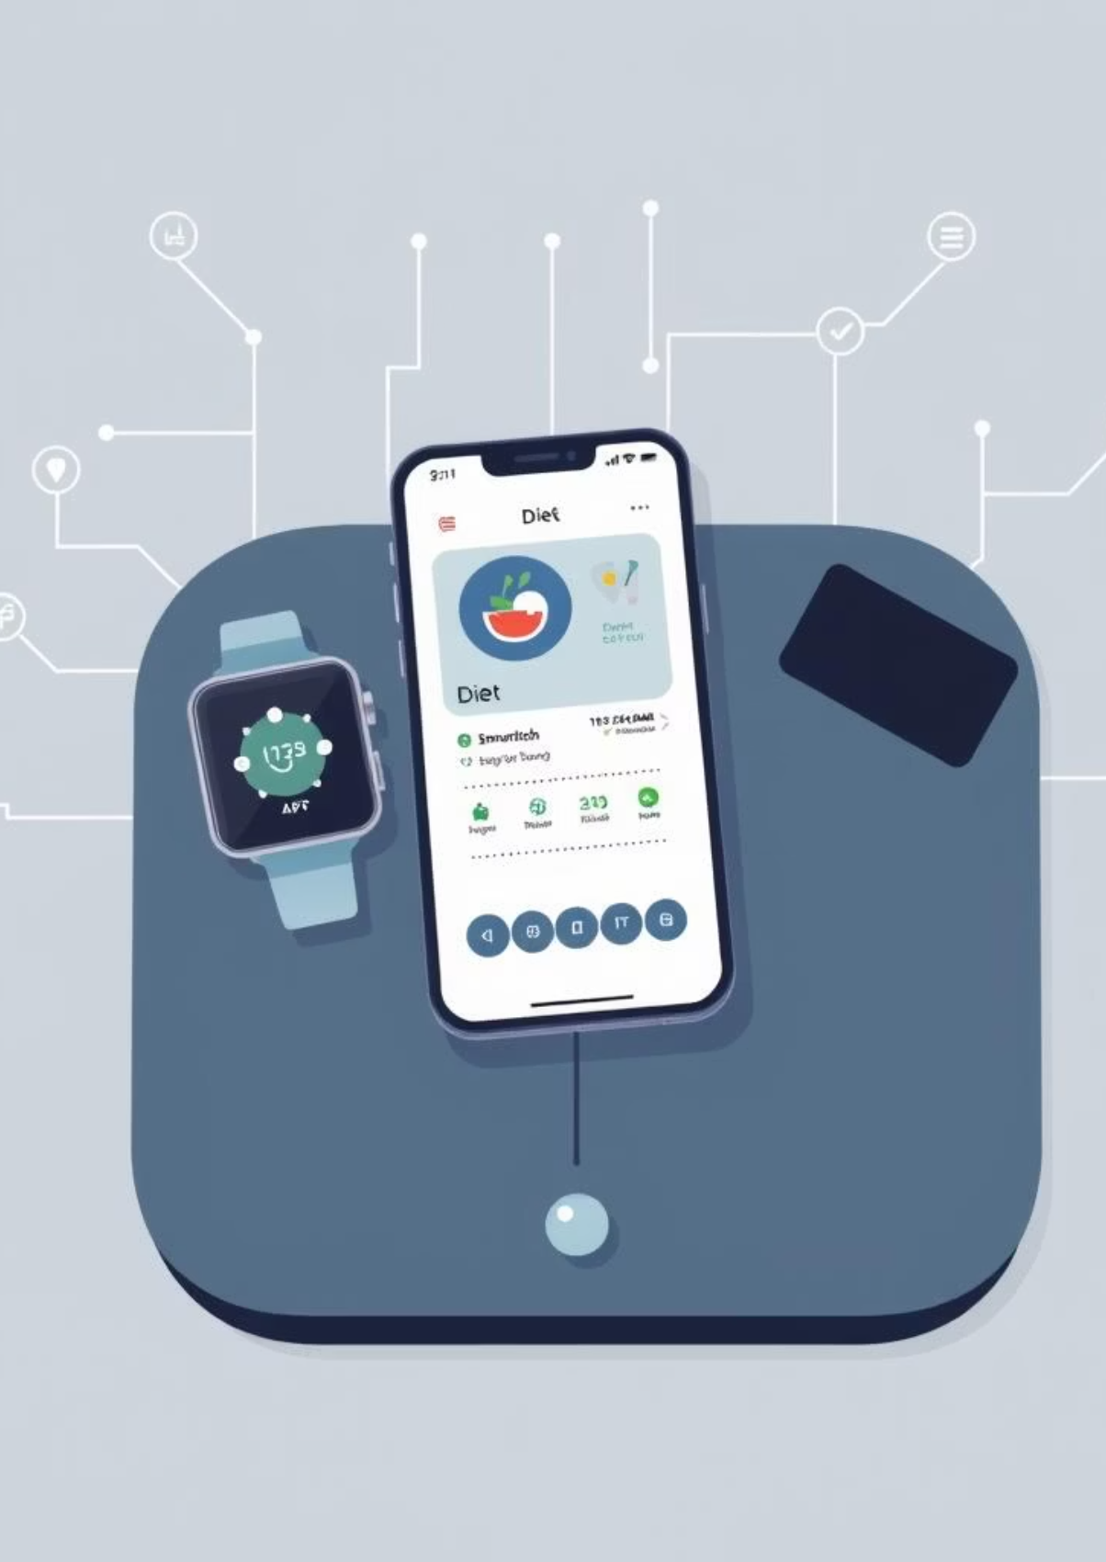
Literature review (PART 2)
Personalized Nutrition and AI-Powered Systems: AI powered diet recommendation systems have emerged as a promising solution for providing personalized nutrition advice. These systems can analyze individual characteristics, such as age, sex, weight, and health goals, to provide tailored dietary recommendations.
Machine Learning Algorithms for Diet Recommendation: Various machine learning algorithms, including collaborative filtering, content-based filtering, and deep learning, have been employed to develop diet recommendation systems. These algorithms have demonstrated effectiveness in providing personalized dietary advice.
Data Integration and Food Ontology: Integrating data from various sources, such as wearable devices, electronic health records, and food diaries, can enhance the accuracy and effectiveness of diet recommendation systems. The development of food ontologies can facilitate the creation of more comprehensive and accurate diet recommendation systems.

Slide 5

Literature review (part 3)
In a study by Rashid et al. (2022), an AI-powered personalized diet recommendation system using Random Forest and KNN classifiers achieved:
Accuracy: 92.4% in matching meal plans to individual health goals.
Precision: 90.8% in correctly suggesting medically safe foods for users with dietary restrictions.
User satisfaction score: 4.6/5 from 150 participants after 4 weeks of usage.
Similarly, Kumar & Singh (2021) implemented a hybrid recommendation model (content-based + collaborative filtering) for nutrition planning and reported:
Diet plan adherence improvement: 28% compared to manual diet charts.
BMI reduction: Average decrease of 1.4 points over 8 weeks for weight-loss goal users.

Slide 6
Literature review (part 4)
In the evolving landscape of healthcare, the integration of Artificial Intelligence (AI) has introduced an innovative approach to personalized patient care. An extensive framework is introduced for an AI-powered healthcare recommender system, dedicated to providing customized health and wellness recommendations. Users create profiles to maintain health history, preferences, and real-time data, while recommendations are generated using advanced algorithms, regularly refined for accuracy. Real-time health monitoring, via wearable devices and health apps, ensures the latest health metrics inform recommendations. The AI-driven recommendation engine draws on the latest medical research to provide evidence-based advice. Privacy and data security are priorities, with stringent measures to protect sensitive health data and comply with data protection regulations. 0The user-friendly interface offers easy access to recommendations, progress monitoring, and health-related information. Continuous improvement is core, with user feedback and data analytics driving recommendation enhancements. This framework harnesses AI's potential in healthcare, emphasizing personalization, security, and ongoing optimization for individuals and the broader healthcare ecosystem.

Slide 7
METHODOLOGY USED
1. Data Preprocessing
Goal: Clean, normalize, and prepare food, nutrition, and activity data for analysis. Datasets to Use:
USDA FoodData Central – Base nutritional reference for preprocessing food-related inputs.
Open Food Facts – Brand/product-level nutrition info (requires cleaning due to inconsistencies).
NHANES Dietary Data – Pre-labeled survey data for testing preprocessing pipelines.

Slide 8
2. Machine Learning Algorithms
a. Collaborative Filtering
Goal: Recommend based on similar users’ preferences. Datasets:
MyFitnessPal Public Logs – User-meal interactions (can be anonymized for collaborative models).
Fitbit + Diet Logs (research datasets) – Linking physical activity with diet patterns.
b. Content-Based Filtering
Goal: Recommend meals matching user profile (diet type, restrictions, macros). Datasets:
USDA FoodData Central – Nutritional content matching.
Recipe1M+ – Recipes with structured ingredients and nutrition values.
c. Deep Learning
Goal: Learn complex diet-health patterns. Datasets:
Nutrition5k – Nutritional breakdown of prepared meals.
Food-101 – For adding food image recognition to recommendations.

Slide 9
3. Calorie & Activity Tracking
Goal: Compare calorie intake vs. expenditure, give feedback. Datasets:
Fitbit Activity Data – Steps, calorie burn, heart rate.
NHANES Physical Activity + Dietary Intake – Validated research dataset linking exercise and diet.
4. User Profiling
Goal: Build dynamic user profiles (age, weight, activity, goals, allergies). Datasets:
NHANES Demographic Data – Demographics + health stats for model tuning.
WHO Global Dietary Database – Demographic-based dietary patterns.

Slide 10
5. Recommendation Generation
Goal: Deliver personalized diets/workouts considering goals & constraints. Datasets:
Combination of USDA, Recipe1M+, Nutrition5k for meal planning.
Clinical nutrition datasets for condition-specific recommendations (e.g., low-sodium diets for hypertension).
6. System Evaluation
Goal: Evaluate accuracy, precision, and user satisfaction. Datasets:
Held-out test set from custom app-collected data.
Public benchmark diet datasets (small-scale, e.g., Kaggle’s Nutrition Facts for fast prototyping).

Slide 11
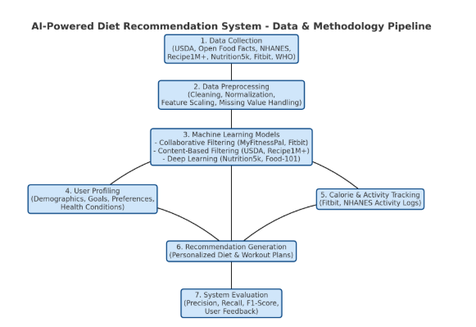
Ai-Training pipeline diagram

Slide 12
Conclusion
The work so far has established a clear, structured roadmap for developing an AI-powered diet recommendation system that is both scientifically grounded and technically feasible. By systematically mapping the methodologies from the research paper to real-world datasets, we have ensured that every stage of the AI pipeline — from data collection to system evaluation — is backed by credible, high-quality data sources.
The pipeline diagram provides a visual blueprint for how these components interact, ensuring smooth transitions between preprocessing, modeling, user profiling, tracking, and recommendation generation. This structure also allows for scalability, supporting future integrations like wearables, EHRs, food image recognition, and gamification.
With this foundation in place, the project is positioned to move from concept to prototype, leveraging machine learning techniques like collaborative filtering, content-based filtering, and deep learning to deliver personalized, adaptive diet and fitness plans. The approach prioritizes user-centric design, accuracy, and feedback loops, making it adaptable to a wide variety of users, from casual health enthusiasts to those with specific medical dietary needs.
In short, we now have:
A well-defined methodology
Mapped datasets for training
A complete AI pipeline design
This sets the stage for the next phase: implementation and model training, which will transform this framework into a functional, intelligent diet assistant capable of improving health outcomes at scale.

